Slide 1

Presented By
Firoz Mahmud
Assistant Professor
Dept. of Computer Science & Engineering
Rajshahi University of Engineering & Technology

Slide 2

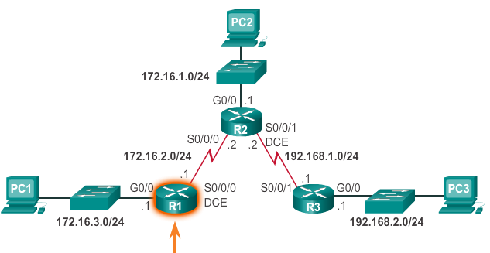
Consider it as a sample Network
Notes:
6.2.1.6 Verify a Static Route

Slide 3

Before configure default static route: R1
  Check show ip route now.
    Remember the result.
  Ping 172.16.2.2 from PC1.
    Remember the result.
Configure default static route: R1
  Ip route 0.0.0.0 0.0.0.0 172.16.2.2
  Check show ip route now.
    Is that any difference?
Notes:
6.2.1.6 Verify a Static Route

Slide 4

  Again check Ping 172.16.2.2 from PC1. Anything??
Don’t worry, I’m here ☺
Configure default static route: R2
  Ip route 0.0.0.0 0.0.0.0 172.16.2.1
  Now Ping 172.16.1.2 from PC1. cheers.
  Ping 192.168.1.2 ☺
  I swear last time ping 172.16.1.1
Do the same work on R2 and R3 router.
Notes:
6.2.1.6 Verify a Static Route

Slide 5

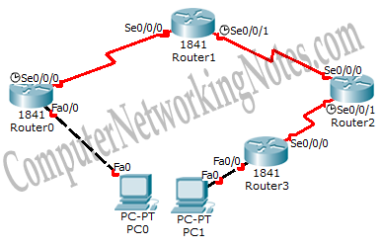
Notes:
6.2.1.6 Verify a Static Route

Slide 6
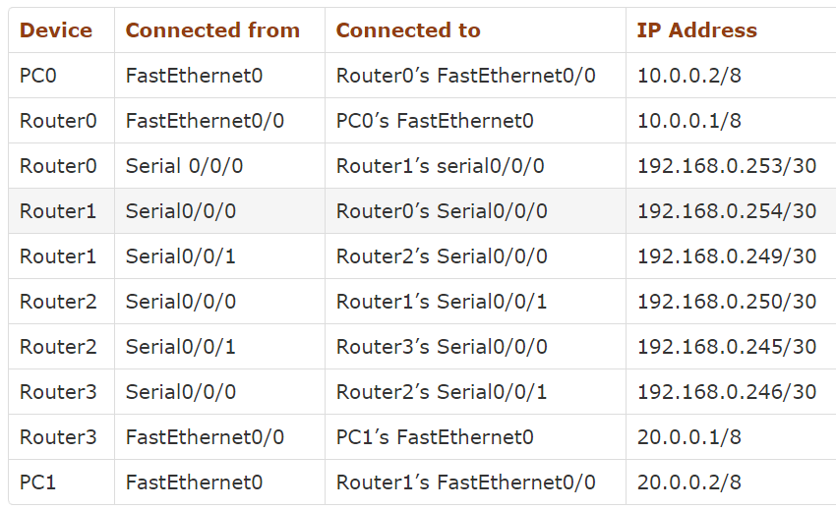
Notes:
6.2.1.6 Verify a Static Route

Slide 7

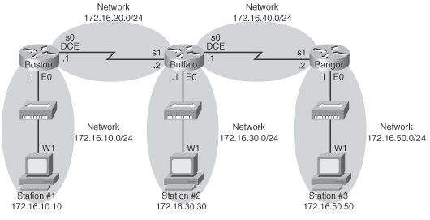
Notes:
6.2.1.6 Verify a Static Route

